Slide 1
Node js
Create your own server

Slide 2
What is node
Node.js is a popular open-source, cross-platform JavaScript runtime environment that executes JavaScript code outside of a web browser. Let's dive into some of its key aspects:

Slide 3
What is Web server
A web server is a software application or hardware device that stores, processes, and serves web pages to users over the Internet. It plays a crucial role in the delivery of content for websites, and understanding its functions can help you recognize why it's necessary for most online activities. Here's a breakdown of what a web server is and why you might need one:

Slide 4
Why Do You Need a Web Server?
Hosting a Website: If you want to make a website available to others on the Internet, you'll need a web server to host the site's files and handle incoming requests.
Creating a Web Application: For more complex sites with dynamic content, a web server can interpret programming languages like PHP, Ruby, or Python, allowing for interactive features and data-driven content.
Managing Traffic: Web servers are designed to manage multiple connections simultaneously, ensuring that many users can access a site at the same time without significant slowdowns.
Security and Access Control: Web servers can be configured to provide security measures, such as SSL/TLS for encrypted connections, and access controls to restrict who can view certain parts of a website.
Content Delivery and Optimization: Web servers can be optimized to deliver content efficiently, with features like compression, caching, and load balancing to ensure quick page loading and responsiveness.
Integration with Databases: In many modern web applications, web servers interact with databases to store and retrieve information, allowing for personalized and dynamic content.
Business and E-Commerce Applications: For businesses that conduct transactions online or provide customer portals, web servers are essential for managing these complex, interactive platforms.

Slide 5
What we are going to do
Node.js
Prisma

Slide 6
Node.js Overview steps
Create a Project Directory
Initialize a New Node.js Project
Install Express.js
Create a Server File
Write the Server Code
Run the Server
Access Your Server

Slide 7
Create a Project Directory
mkdir my-node-server-ts
cd my-node-server-ts

Slide 8
Initialize a New Node.js Project
npm init -y

Slide 9
Install TypeScript, Express, and TypeScript Node
Install TypeScript, Express.js (a popular web framework), and ts-node (a TypeScript execution environment for Node) using the following command:
npm install typescript express ts-node
Install Type Definitions
npm install --save-dev @types/node @types/express

Slide 10
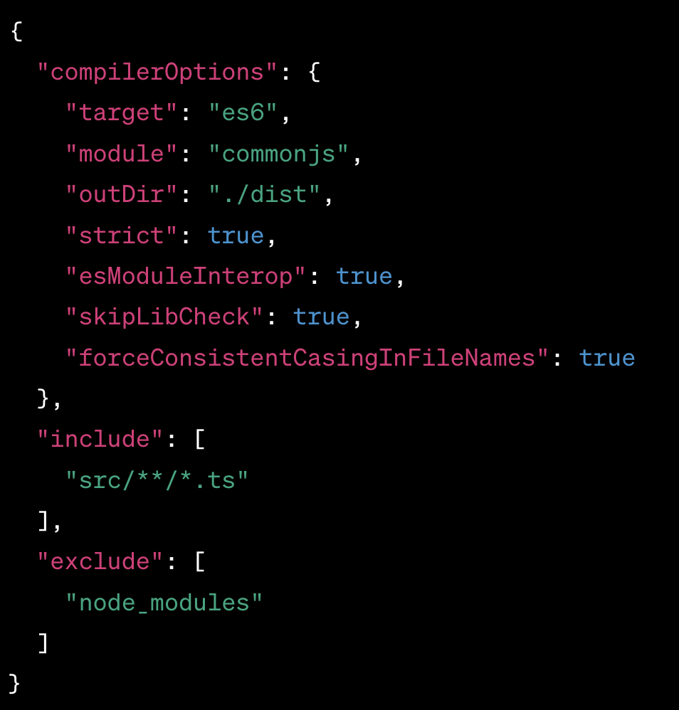
Create a TypeScript Configuration File
Create a tsconfig.json file to configure TypeScript compilation options:

Slide 11
Create a Source Directory
Create a Server File (server.ts)

Slide 12
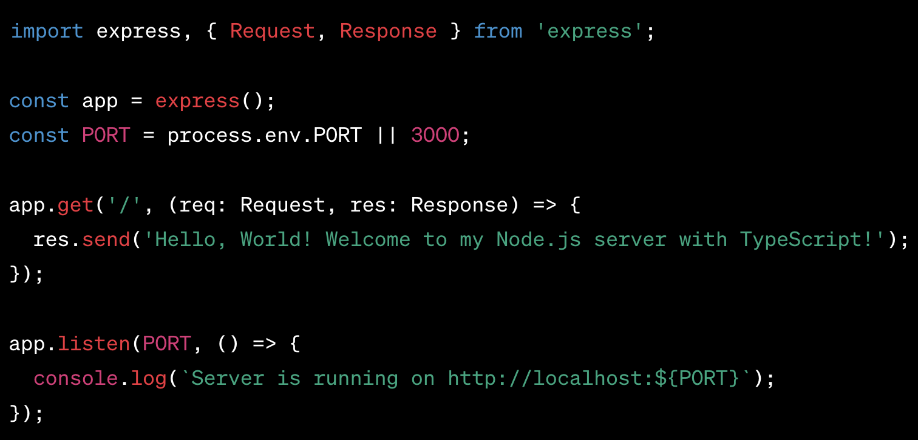
Write the Server Code

Slide 13
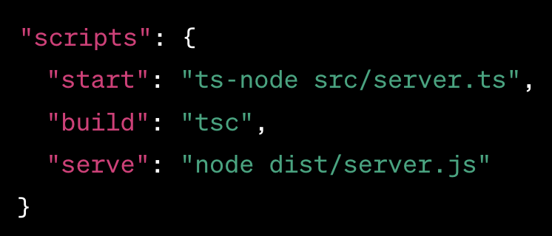
Add Start Scripts

Slide 14
Run the server
Npm start

Slide 19
What is V8 JavaScript Engine
Node.js uses Google's V8 JavaScript engine to execute code. V8 is the same engine used in Google Chrome and other Chromium-based browsers, and it compiles JavaScript directly to native machine code for fast execution.

